Slide 1
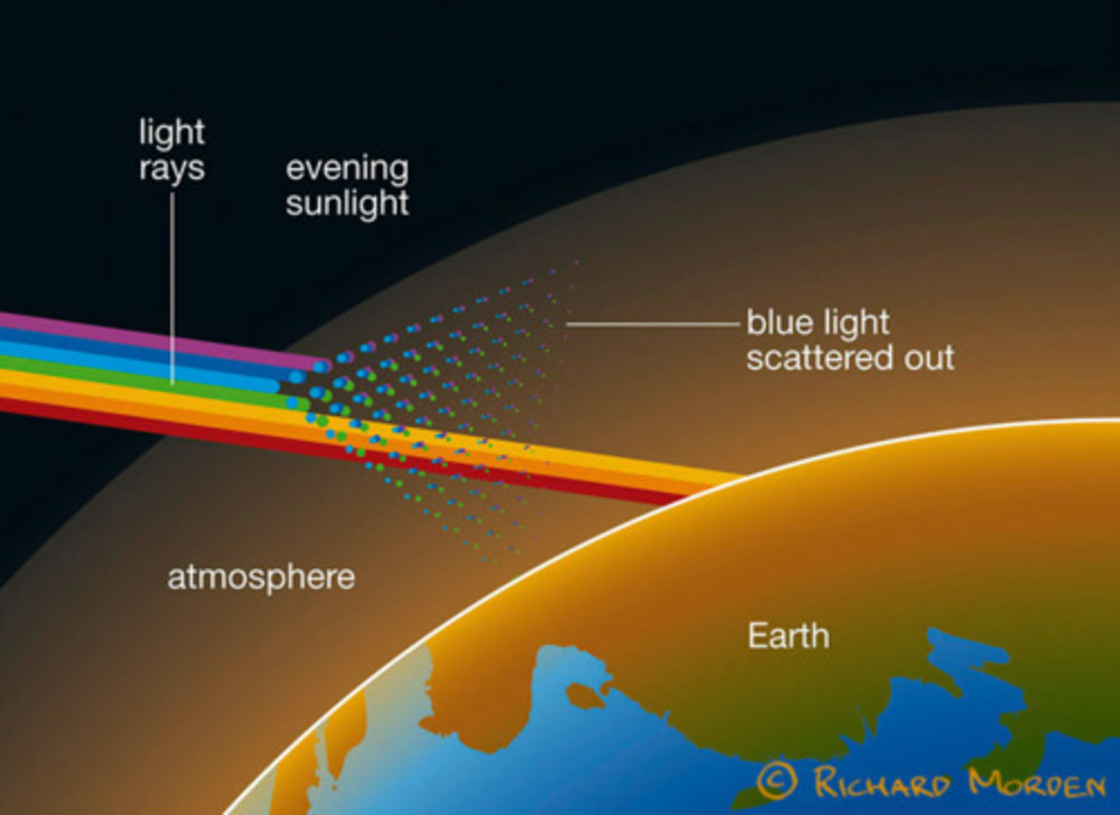
Expt.-1: Small Angle Light Scattering
Scattering: The redirection of light that takes place when an electromagnetic (EM) wave encounters an obstacle or non-homogeneity.
Scattering is the reason behind blue sky, white clouds and red sun at sunrise and sunset.

Slide 2
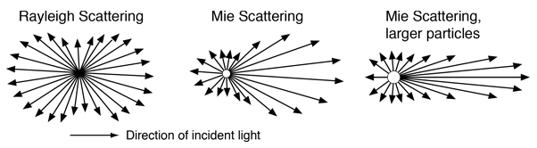
Types of Scattering
Rayleigh Scattering:
Particle size of the scatterer is much smaller than the incident light wavelength (2πr/λ << 1).
Independent of particle size.
Uniform in all direction.
Mie Scattering:
Particle size is equivalent or greater than the incident light wavelength (2πr/λ ≥1).
Dependent on particle size.
Dominant in forward direction.

Slide 3
Motivation:
The Particle size plays important role in chemical and drug industry.
The rate of chemical reactions, dissolution rate, effectiveness of drug delivery are some parameters which is affected by particle size.
We can determine the particle size by microscopic techniques (like Scanning Electron Microscopy and Atomic Force Microscopy).
The Light Scattering provides us the cost-effective tool to determine the particle size.
Aim: To determine the particle size in a colloidal solution (polystyrene beads) using scattering of light.
Motivation and Aim

Slide 4
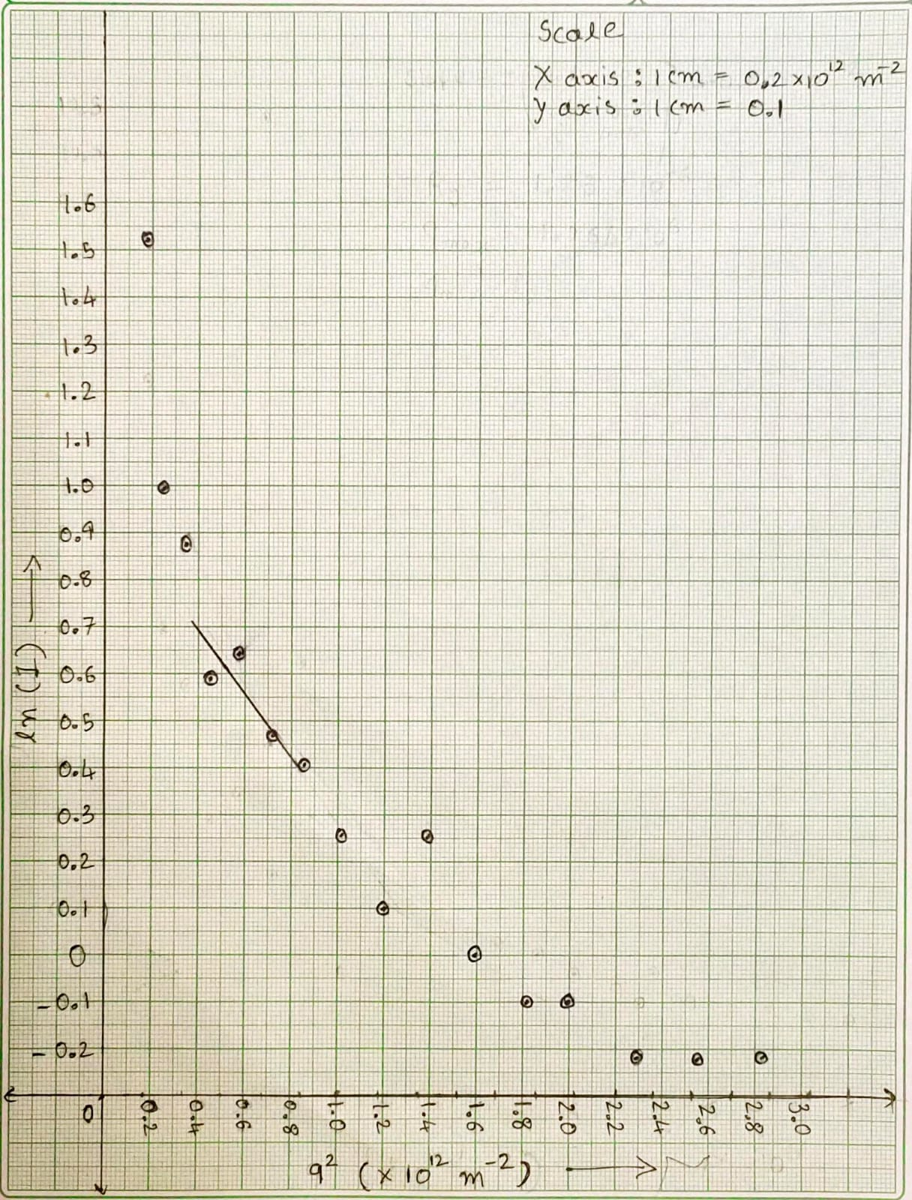
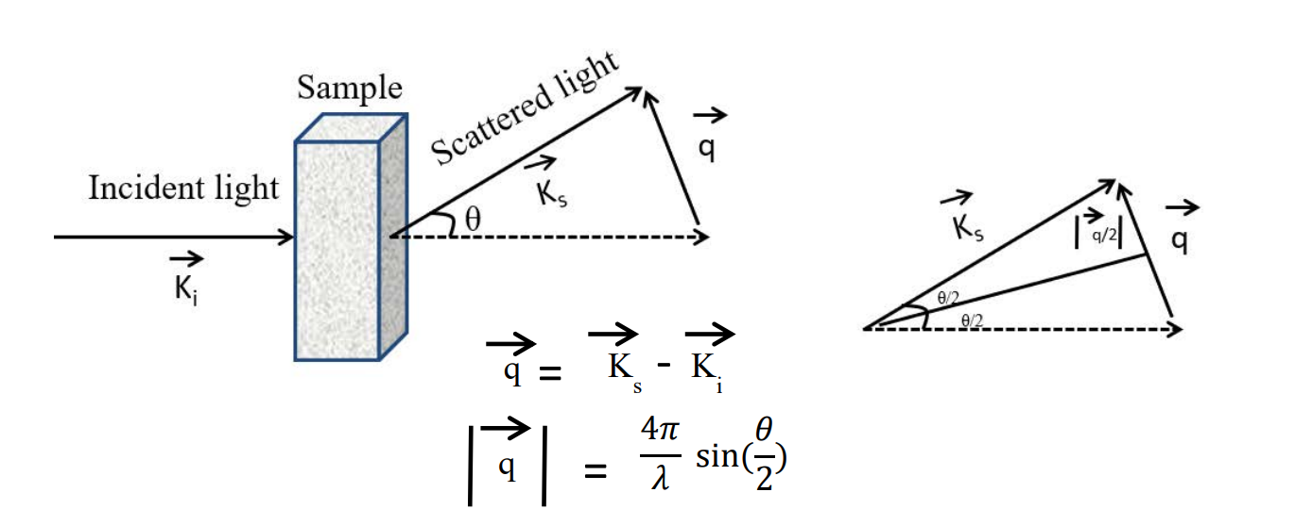
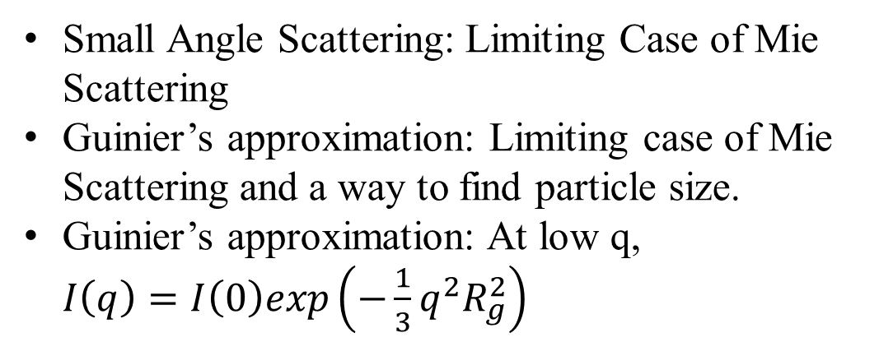
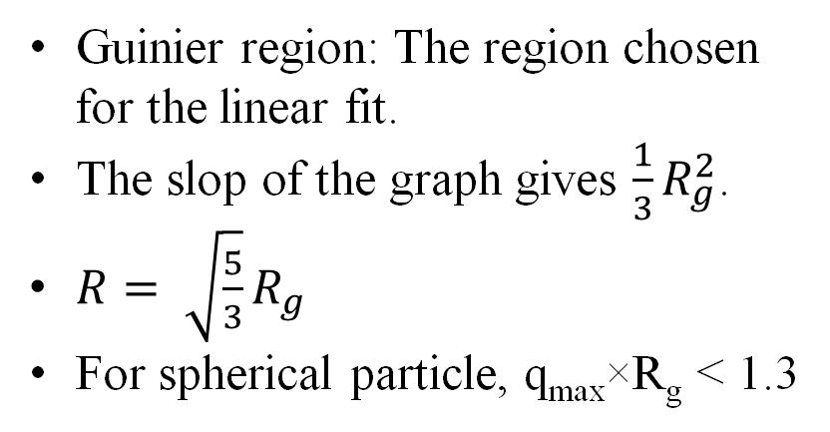
Concept
Guinier plot: ln(I) vs. q²
Small Angle Scattering: Limiting Case of Mie Scattering
Guinier’s approximation: Limiting case of Mie Scattering and a way to find particle size.
Guinier’s approximation: At low q, $I\left(q\right)=I\left(0\right)exp\left(−\frac{1}{3}q^{2}R_{g}^{2}\right)$
Guinier region: The region chosen for the linear fit.
The slop of the graph gives $\frac{1}{3}R_{g}^{2}$.
$R= \sqrt{\frac{5}{3}}R_{g}$
For spherical particle, q_{max}×R_{g} < 1.3

Slide 5
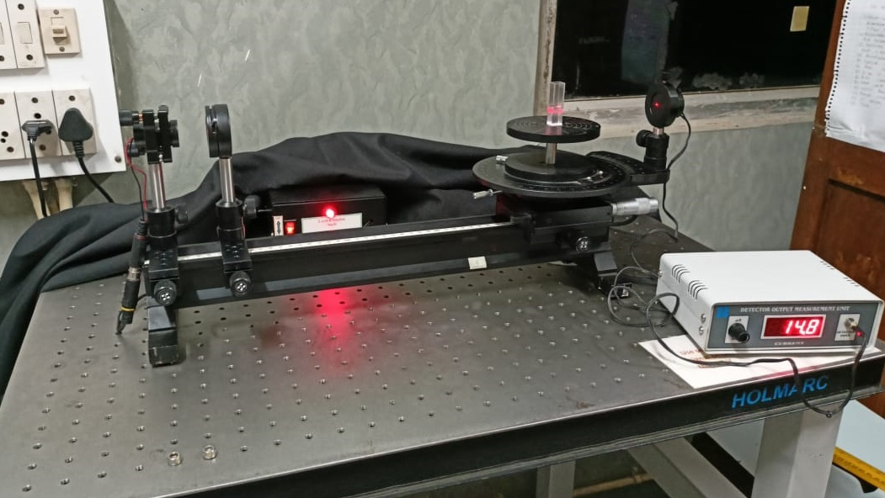
Scattering Solution
LASER
Aperture
Photodiode
Goniometer
Experimental Setup

Slide 6
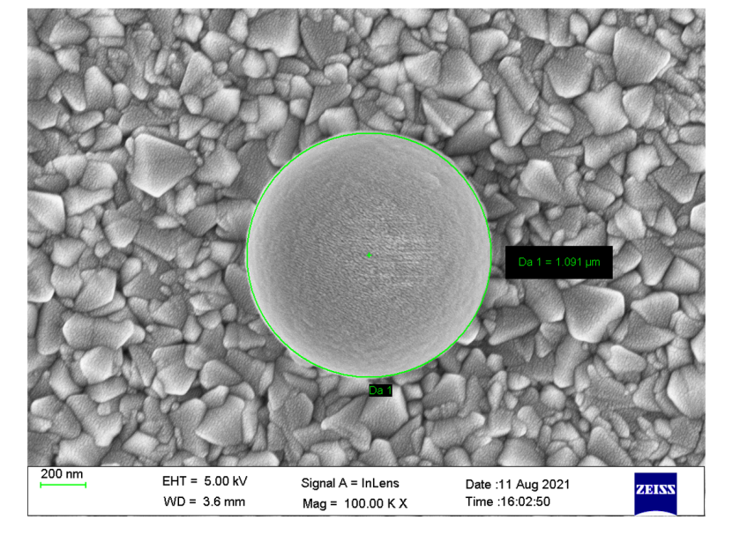
Objectives and Conclusion
Objectives:
Measure the photocurrent as a function of angle.
Plot the graph and find out the required parameters from it.
Calculate the particle size.
Check the validity of slope
Conclusion:
The particle size can be detected using simple and cost-effective scattering technique.
The particle of size of polystyrene beads has been measured and compared with the size obtained from SEM image.
SEM image of Polystyrene Beads

Slide 7

Further Reading
http://plaza.ufl.edu/dwhahn/Rayleigh%20and%20Mie%20Light%20Scattering.pdf
http://hyperphysics.phy-astr.gsu.edu/hbase/atmos/blusky.html#c2
https://sites.google.com/a/umn.edu/mxp/student-projects/spring-2018/s18_mie-scattering
https://bioxtas-raw.readthedocs.io/en/latest/saxs/saxs_guinier.html
https://www.ncbi.nlm.nih.gov/pmc/articles/PMC8662971/pdf/j-54-01832.pdf

